Slide 1

JavaScript and jQuery Course
Class 11

Slide 2
jQuery
jQuery is a JavaScript library
Makes writing JavaScript easier
Uses methods based on native JavaScript functions / DOM
Free / open source

Slide 3

jQuery
Eliminates JS complexity
Cross browser compatibility
Uses CSS3 compliant selectors
Thousand of plugins

Slide 4
jQuery
2006 by John Resig
Current Version (Sept 2016) - v3.1.1
Other libraries
Dojo - 2004
YUI (Yahoo User Interface) - 2005
Prototype, Mootools - 2006
Angular, Backbone, React, Ember, Node.js,

Slide 5
Versions
Migrate plugins

Slide 6
How to use the jQuery Library
You can host the file yourself by downloading it from ww.jquery.com
You can use a hosted version from a Content Delivery Network (CDN)

Slide 7
How to use the jQuery Library - CDN
Google Hosted Library
<script src="http://ajax.googleapis.com/ajax/libs/ jquery/3.1.1/jquery.min.js">
</script>

Slide 8
Using the jQuery Library
jquery.com/download
<script
src=https://code.jquery.com/jquery-3.1.1.min.js
integrity="sha256-hVVnYaiADRTO2PzUGmuLJr8BLUSjGIZsDYGmIJLv2b8="
crossorigin="anonymous">
</script>
Subresource Integrity (SRI) checking

Slide 9
Using the jQuery Library
Download the file and host it yourself
<script src="jquery.js">
</script>

Slide 10
What is the “min” all about?
The minified version
Minification
removes all unnecessary characters from source code
without changing its functionality
these characters usually include white space characters, new line characters, comments, and sometimes block delimiters
which are used to add readability to the code but are not required for it to execute

Slide 11
Where to put jQuery code
Place this code after any CSS in the <head> - jQuery references styles from the stylesheet
Must precede any other JavaScript in the <head>
Can also place all of the jQuery at the bottom

Slide 12
Sample Document – using a CDN
<head> <link rel="stylesheet" href="styles.css"> <style> /* CSS here */ </style> <script src="http://code.jquery.com/jquery.min.js">
</script>
<script> // other jQuery / JS code goes here </script>
</head>

Slide 13
The “ready” event
$(document).ready();
waits until the HTML page has loaded before it runs your code
similar to window.onload
$ is used to indicate an object reference

Slide 14
The ready event
framework
<script src="http://code.jquery.com/jquery-latest.min.js"></script>
<script> $(document).ready(function() { // code here
}); </script>
Anonymous Function
Ending trio

Slide 15
The ready event shorthand
$(function() { // code here
});

Slide 16
Testing the Library
$(document).ready(function() {
alert("The DOM is ready");
}); // end ready

Slide 17
jQuery
Based upon CSS selectors
element
class
id
others

Slide 18
DOM
Also based upon selectors
document.getElementById("some_id");
document.getElementsByTagName("some_tag");

Slide 19
Selector Syntax
$('selector');
$("selector");

Slide 20
Selector Syntax
Element selector
<h1></h1>
$("h1");

Slide 21
Selector Syntax
id selector
<h1 id="firstHeading"></h1>
$("#firstHeading");

Slide 22
Selector Syntax
class selector
<h1 class="red"></h1>
$(".red");

Slide 23
Selector Syntax
descendant selector
<h1 class="red"> A <i>big</i> cat</h1>
$(".red i");

Slide 24
Selector Syntax
multiple selectors
<h1 class="red"> A <i>big</i> cat</h1>
<h2 id=“xyz"> A unique heading </h2>
$(".red i, #xyz");

Slide 25
Syntax for Calling Methods
$("selector").methodName(optional parameters);
methods can get or set a value

Slide 26
Common Methods
val() | Retrieve value from textbox
val(value) | Sets value for textbox
text() | Retrieve text of selected element
text(value) | Set text of selected element
next(type) | Get the next sibling of the specified type
html() | Retrieve the HTML of the selected element
html(value) | Set the HTML of the selected element
css(propertyName) | Retrieve the value
css(propertyName, value) | Set the property/value

Slide 27
Basic jQuery Selectors
element selector
$(document).ready(function() {
$("h1").html("Hello World");
$("h2").html("Hello World <i>Again</i>");
});
<h1> </h1>
<h2> </h2>

Slide 28
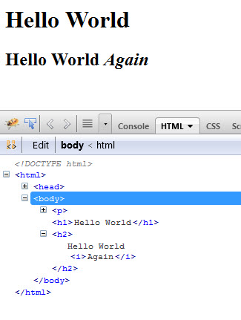
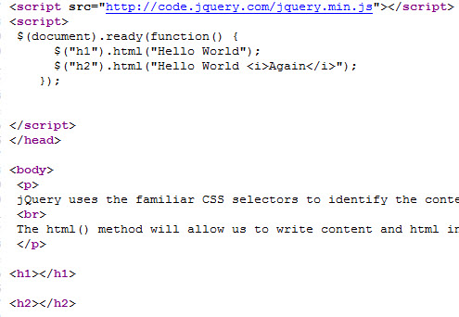
Basic jQuery Selectors
View Rendered Code in Firebug
browser
firebug
view source

Slide 29
Basic jQuery Selectors
id selector
$(document).ready(function() {
$("#firstHeading").html("Hello World");
});
<h1 id="firstHeading"> </h1>

Slide 30
Basic jQuery Selectors
class selector
$(document).ready(function() {
$(".para").html("Hello World");
});
<p class="para"> </p>
<div class="para"> </div>

Slide 31
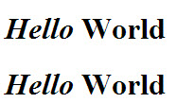
Basic jQuery Methods – html() set
$(document).ready(function() {
$("h1").html("<i>Hello</i> World");
});
<h1>first h1</h1>
<h1>second h1</h1>
all selections and descendants

Slide 32
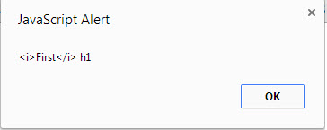
Basic jQuery Methods – html() get
$(document).ready(function() {
var theH1 = $("h1").html();
alert(theH1);
});
__________________________
<h1><i>First</i> h1</h1>
<h1>Second h1</h1>
only first selection

Slide 33
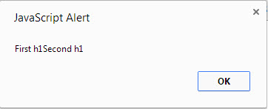
Basic jQuery Methods – text() get
$(document).ready(function() {
var theH1 = $("h1").text();
alert(theH1);
});
__________________________
<h1><i>First</i> h1</h1>
<h1>Second h1</h1>
all selections and descendants

Slide 34
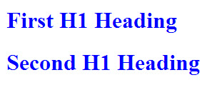
Basic jQuery Methods – css() set
$(document).ready(function() {
$("h1").css("color“ , "blue");
});
__________________________
<h1>First H1 Heading</h1>
<h1>Second H1 Heading</h1>
all selections and descendants

Slide 35
Basic jQuery Methods – css() set multiple
$(document).ready(function() {
$("h1").css({"color" : "blue" , "background-color" : "yellow"});
});
<h1>First H1 Heading</h1>
<h1>Second H1 Heading</h1>

Slide 36
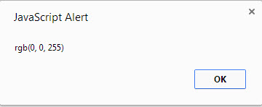
Basic jQuery Methods – css() get
$(document).ready(function() {
var theValue = $("h1").css("color");
alert(theValue);
});
__________________________
<h1 style="color: blue">First H1 Heading</h1>
<h1 style="color: red">Second H1 Heading</h1>
only first selection

Slide 37
Basic jQuery Methods – chaining
$(document).ready(function() {
$("h1").html("<i>Hello</i> World") .css("color" , "red");
});
<h1></h1>

Slide 38
Two common jQuery event methods
ready()
The event handler runs when the DOM is ready
click()
The event handler runs when the selected element is clicked

Slide 39
Event Methods – click event
$(document).ready(function() {
$("h2").click(function() {
alert("You clicked the h2");
}); // end click;
}); // end ready;
<h2>Click me</h2>

